Slide 1

Check point Presentation

Slide 2
Subjects
How Does The Web Work?
What Do you need to be a web developer
Why did you choose to learn web development?

Slide 3

How Does The Web Work?
The Web work as a connection between different servers ,database and clients
The clients is connecting to the servers through a browser or an application directly
If it connect with a browser it must a protocol to fetch the information from a special database an application
If it’s an application it can use an API , or other sort of connection to retrieve data from specified server or database

Slide 4

What Do you need to be a web developer
Creativity
Logical thinking
Skills

Slide 5

Why did you choose to learn web development
Improve my skills
Have better chance to be promoted
Find better opportunities
Try to developpe my own business

Slide 6
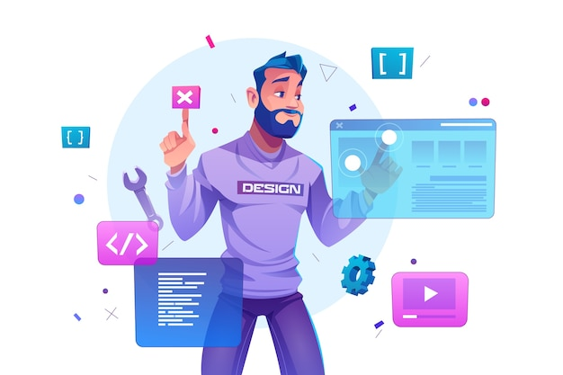
Merci
Thanks For Your Attention

